Slide 1


School of Computing and Information Technology, Eastern International University (EIU) - Vietnam

Slide 2
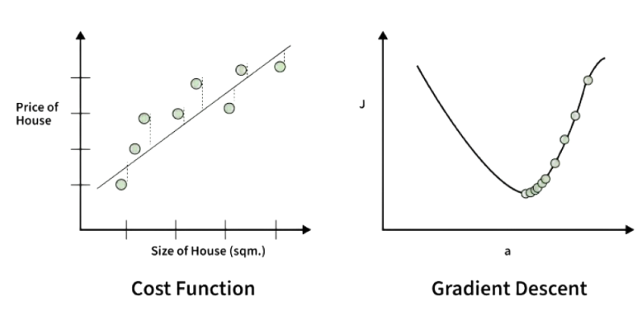
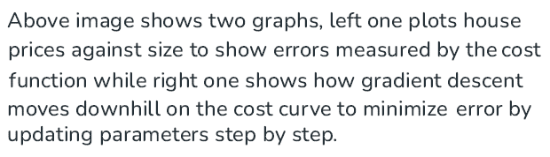
School of Computing and Information Technology, Eastern International University (EIU) - Vietnam

Slide 3
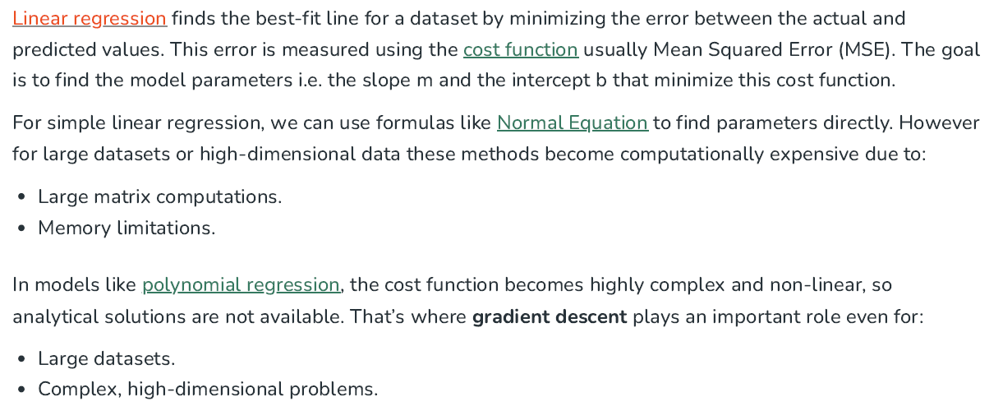
School of Computing and Information Technology, Eastern International University (EIU) - Vietnam

Slide 4
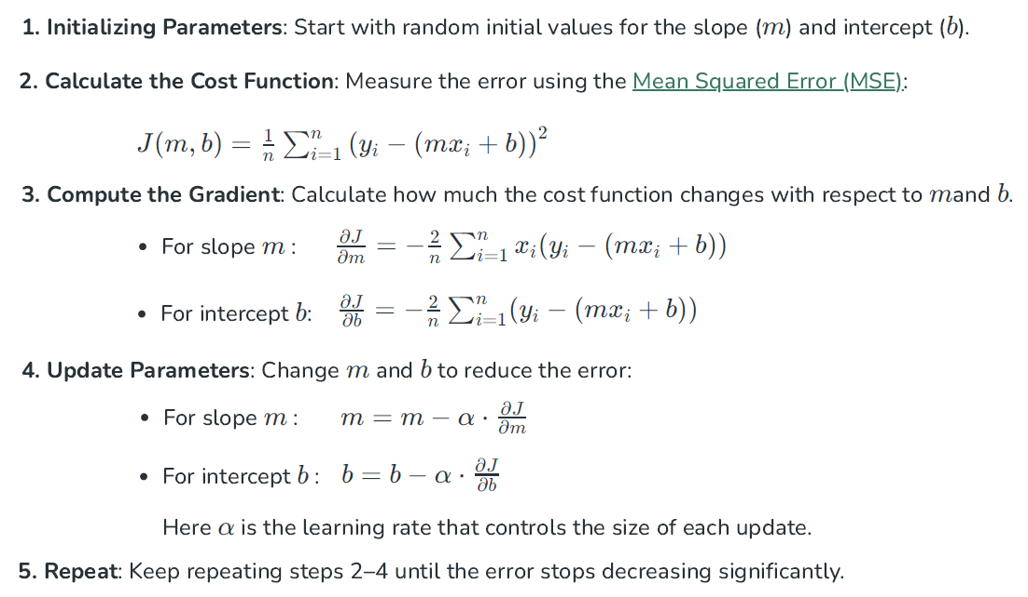

Slide 5
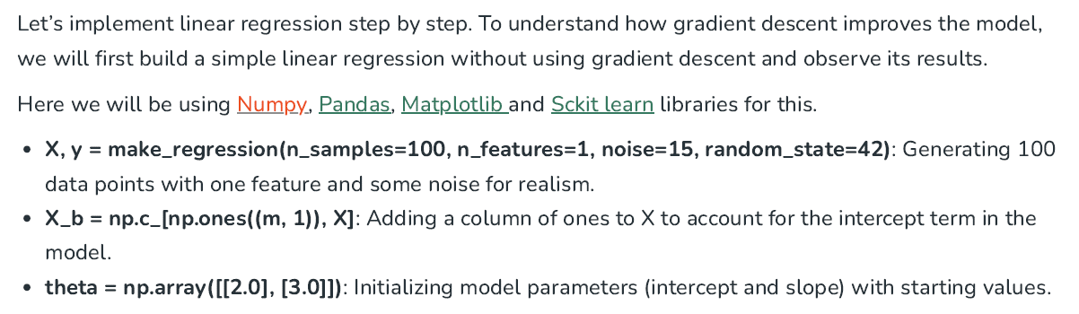
School of Computing and Information Technology, Eastern International University (EIU) - Vietnam

Slide 6
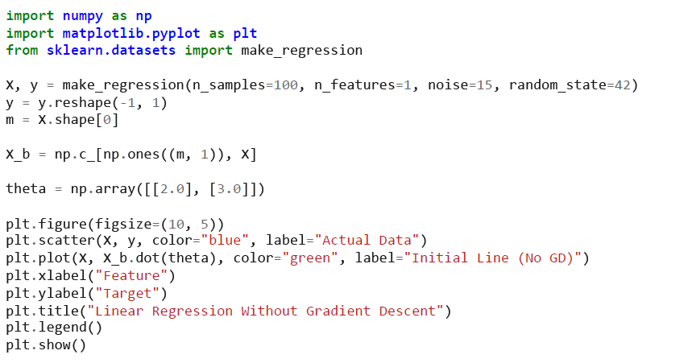
School of Computing and Information Technology, Eastern International University (EIU) - Vietnam

Slide 7
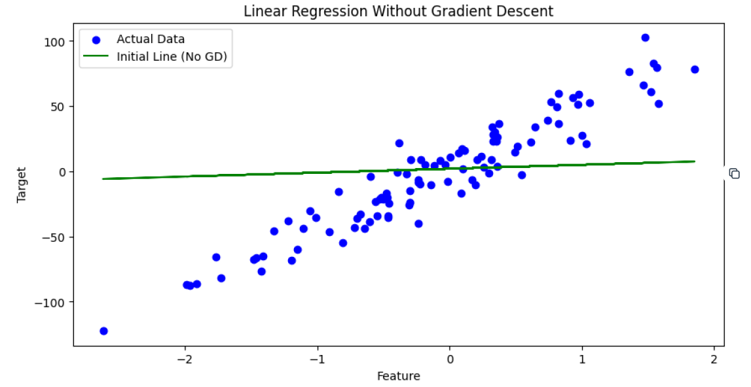
School of Computing and Information Technology, Eastern International University (EIU) - Vietnam

Slide 8
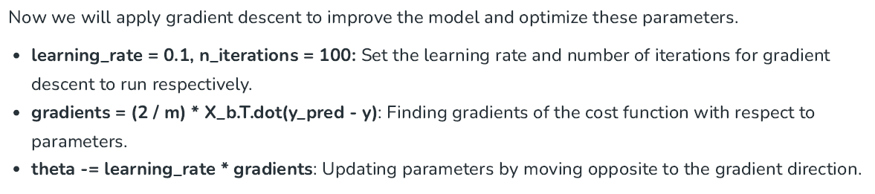
School of Computing and Information Technology, Eastern International University (EIU) - Vietnam

Slide 9
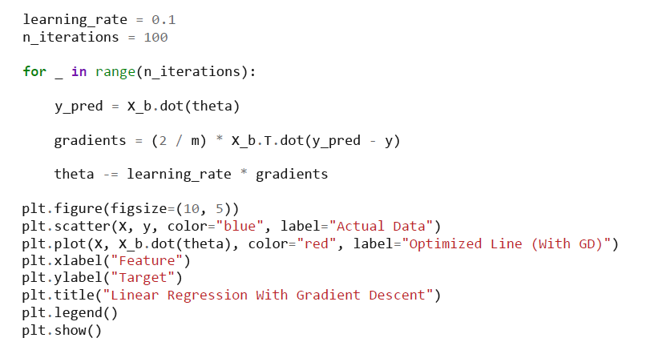
School of Computing and Information Technology, Eastern International University (EIU) - Vietnam

Slide 10
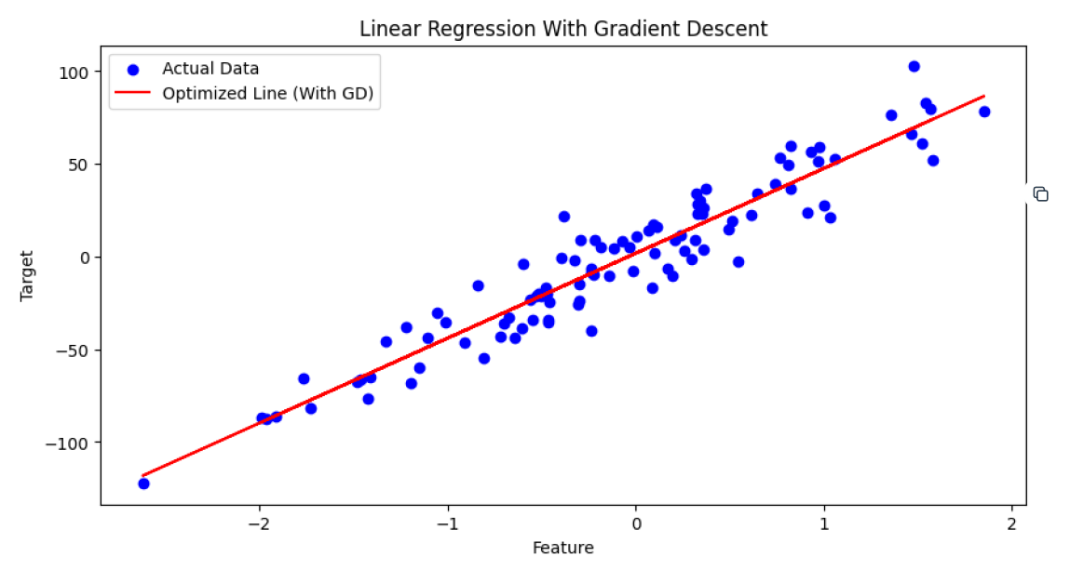
School of Computing and Information Technology, Eastern International University (EIU) - Vietnam

